Slide 1
Chapter 11: Indexing and Hashing

Slide 2
Chapter 11: Indexing and Hashing
Basic Concepts
Ordered Indices
B⁺-Tree Index Files
B-Tree Index Files
Static Hashing
Dynamic Hashing
Comparison of Ordered Indexing and Hashing
Index Definition in SQL
Multiple-Key Access

Slide 3
Basic Concepts
Indexing mechanisms used to speed up access to desired data.
E.g., author catalog in library
Search Key - attribute to set of attributes used to look up records in a file.
An index file consists of records (called index entries) of the form
Index files are typically much smaller than the original file
Two basic kinds of indices:
Ordered indices: search keys are stored in sorted order
Hash indices: search keys are distributed uniformly across “buckets” using a “hash function”.
search-key
pointer

Slide 4





















Slide 5








Slide 6
Index Evaluation Metrics
Access types supported efficiently. E.g.,
records with a specified value in the attribute
or records with an attribute value falling in a specified range of values.
Access time
Insertion time
Deletion time
Space overhead

Slide 7















Slide 8
Ordered Indices
In an ordered index, index entries are stored sorted on the search key value. E.g., author catalog in library.
Primary index: in a sequentially ordered file, the index whose search key specifies the sequential order of the file.
Also called clustering index
The search key of a primary index is usually but not necessarily the primary key.
Secondary index: an index whose search key specifies an order different from the sequential order of the file. Also called non-clustering index.
Index-sequential file: ordered sequential file with a primary index.

Slide 9
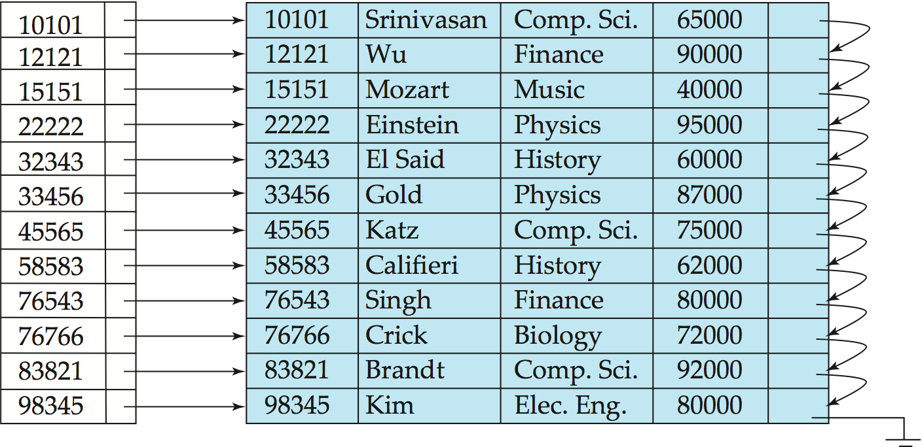
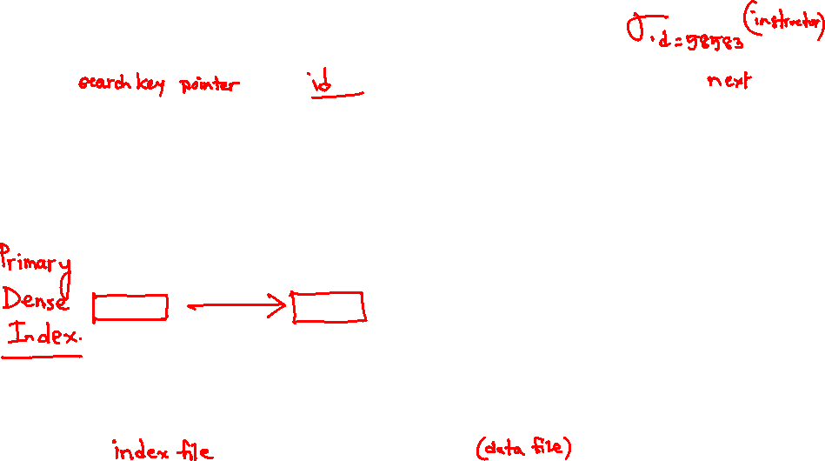
Dense Index Files
Dense index — Index record appears for every search-key value in the file.
E.g. index on ID attribute of instructor relation

Slide 10
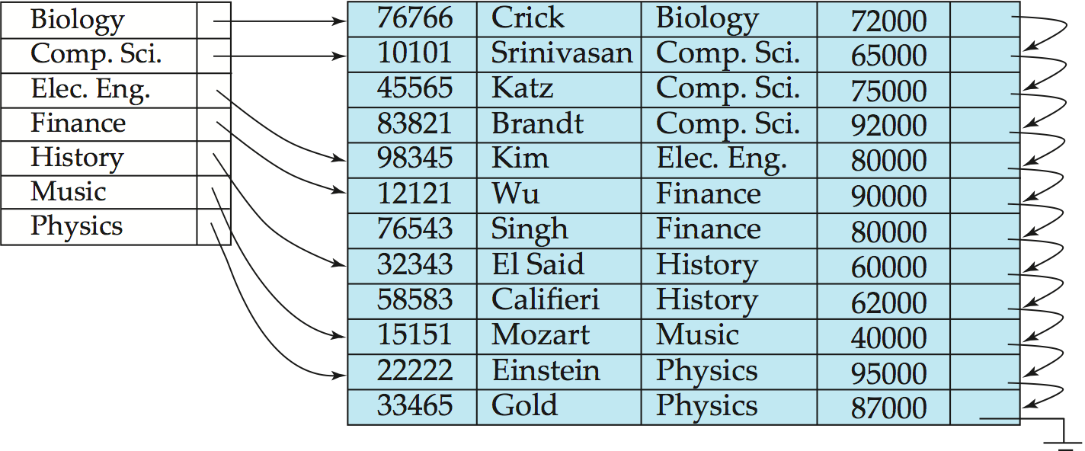
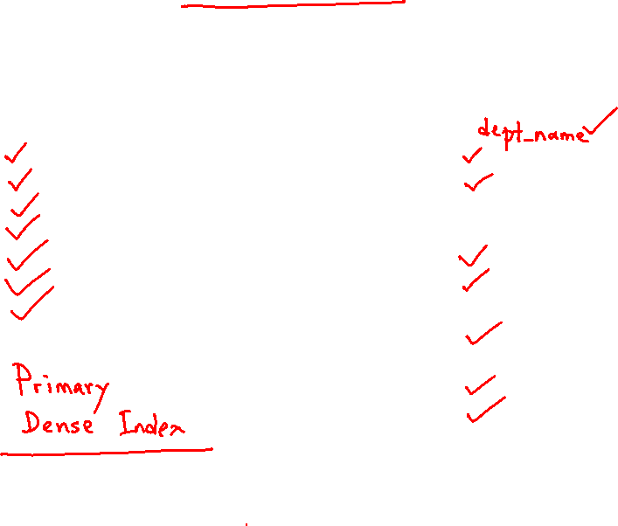
Dense Index Files (Cont.)
Dense index on dept_name, with instructor file sorted on dept_name

Slide 11
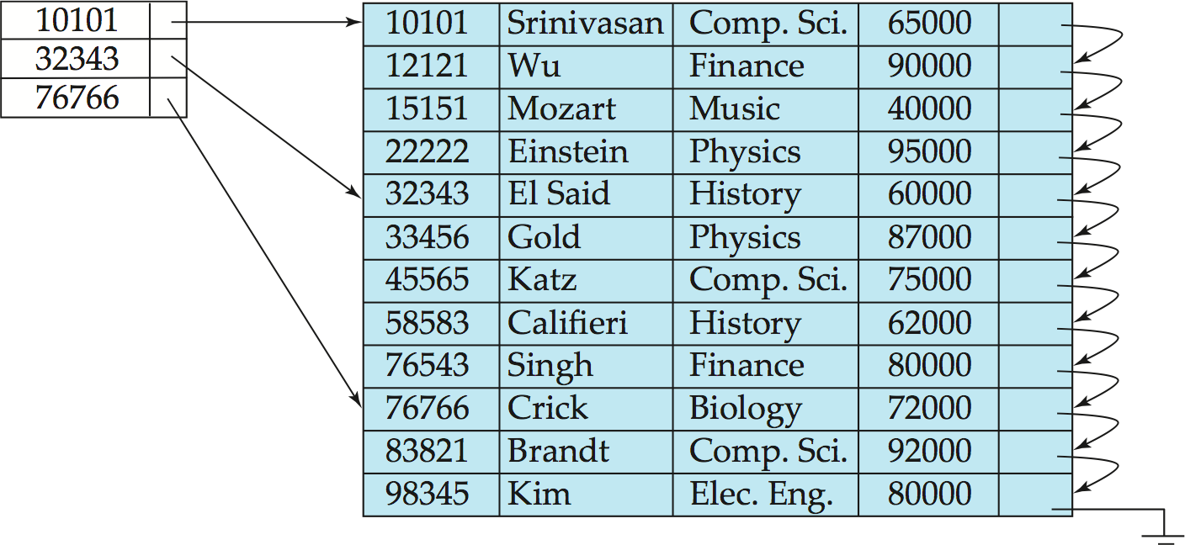
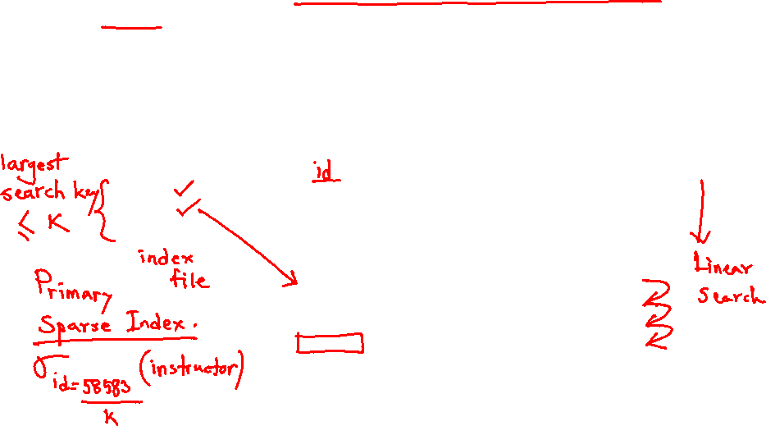
Sparse Index Files
Sparse Index: contains index records for only some search-key values.
Applicable when records are sequentially ordered on search-key
To locate a record with search-key value K we:
Find index record with largest search-key value < K
Search file sequentially starting at the record to which the index record points

Slide 12


Slide 13
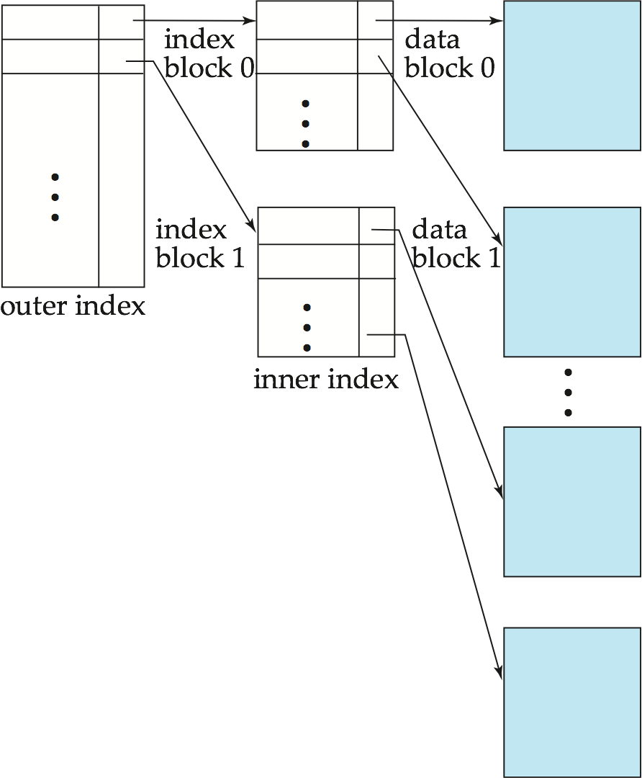
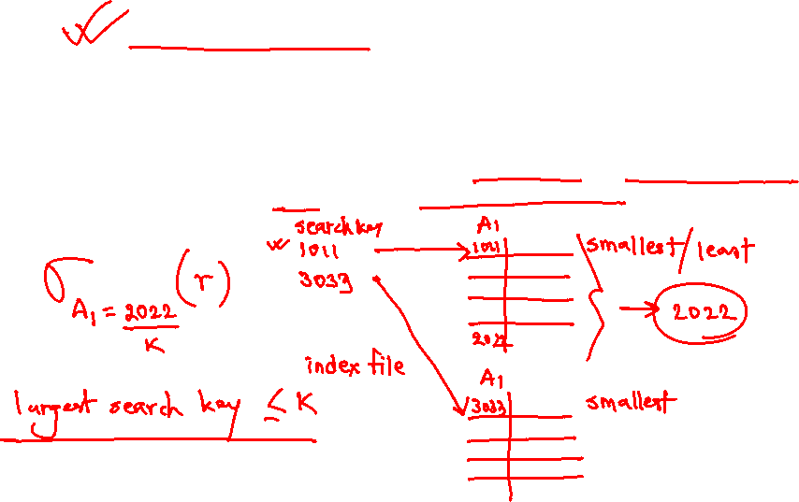
Sparse Index Files (Cont.)
Compared to dense indices:
Less space and less maintenance overhead for insertions and deletions.
Generally slower than dense index for locating records.
Good tradeoff: sparse index with an index entry for every block in file, corresponding to least search-key value in the block.

Slide 14


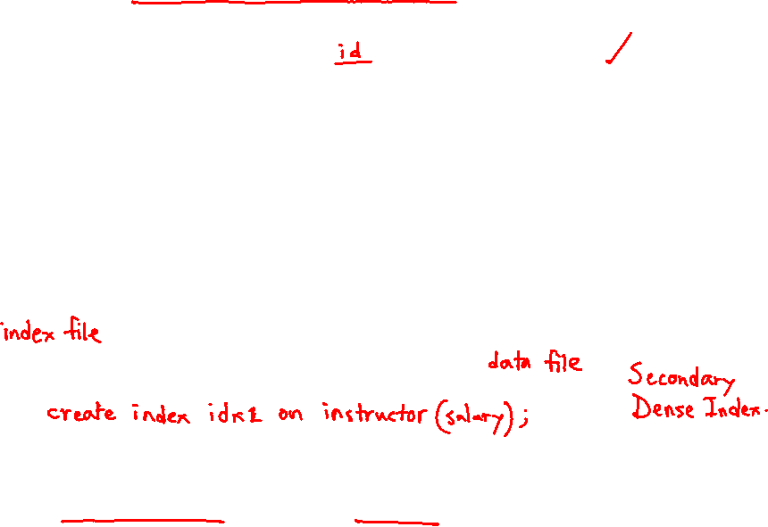

Secondary Indices Example
Secondary index on salary field of instructor
Index record points to a bucket that contains pointers to all the actual records with that particular search-key value.
Secondary indices have to be dense
Notes:
14

Slide 15






























Slide 16
Primary and Secondary Indices
Indices offer substantial benefits when searching for records.
BUT: Updating indices imposes overhead on database modification --when a file is modified, every index on the file must be updated,
Sequential scan using primary index is efficient, but a sequential scan using a secondary index is expensive
Each record access may fetch a new block from disk
Block fetch requires about 5 to 10 milliseconds, versus about 100 nanoseconds for memory access
Notes:
16

Slide 17

Multilevel Index
If primary index does not fit in memory, access becomes expensive.
Solution: treat primary index kept on disk as a sequential file and construct a sparse index on it.
outer index – a sparse index of primary index
inner index – the primary index file
If even outer index is too large to fit in main memory, yet another level of index can be created, and so on.
Indices at all levels must be updated on insertion or deletion from the file.

Slide 18
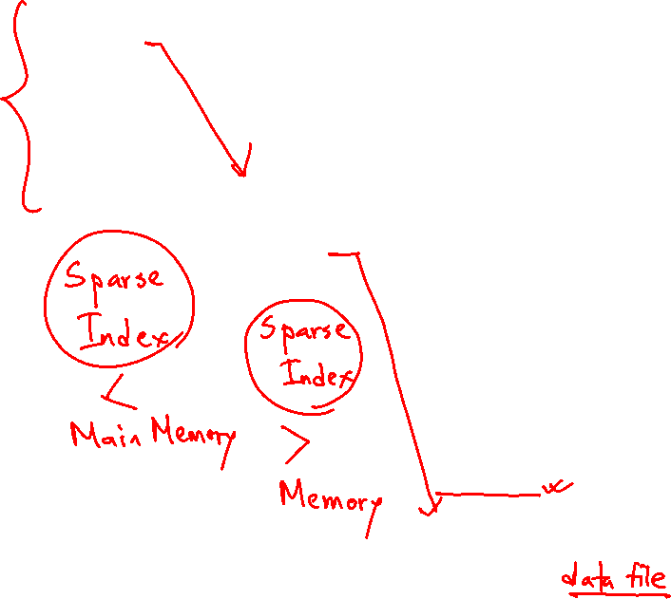
Multilevel Index (Cont.)

Slide 19








Slide 20













Slide 21
Index Update: Deletion
If deleted record was the only record in the file with its particular search-key value, the search-key is deleted from the index also.
Single-level index entry deletion:
Dense indices – deletion of search-key is similar to file record deletion.
Sparse indices –
if an entry for the search key exists in the index, it is deleted by replacing the entry in the index with the next search-key value in the file (in search-key order).
If the next search-key value already has an index entry, the entry is deleted instead of being replaced.

Slide 22
Index Update: Insertion
Single-level index insertion:
Perform a lookup using the search-key value appearing in the record to be inserted.
Dense indices – if the search-key value does not appear in the index, insert it.
Sparse indices – if index stores an entry for each block of the file, no change needs to be made to the index unless a new block is created.
If a new block is created, the first search-key value appearing in the new block is inserted into the index.
Multilevel insertion and deletion: algorithms are simple extensions of the single-level algorithms

Slide 23
Secondary Indices
Frequently, one wants to find all the records whose values in a certain field (which is not the search-key of the primary index) satisfy some condition.
Example 1: In the instructor relation stored sequentially by ID, we may want to find all instructors in a particular department
Example 2: as above, but where we want to find all instructors with a specified salary or with salary in a specified range of values
We can have a secondary index with an index record for each search-key value

Slide 24


B⁺-Tree Index Files
B⁺-tree indices are an alternative to indexed-sequential files.
Disadvantage of indexed-sequential files
performance degrades as file grows, since many overflow blocks get created.
Periodic reorganization of entire file is required.
Advantage of B⁺-tree index files:
automatically reorganizes itself with small, local, changes, in the face of insertions and deletions.
Reorganization of entire file is not required to maintain performance.
(Minor) disadvantage of B⁺-trees:
extra insertion and deletion overhead, space overhead.
Advantages of B⁺-trees outweigh disadvantages
B⁺-trees are used extensively

Slide 25







Slide 26




















Slide 27
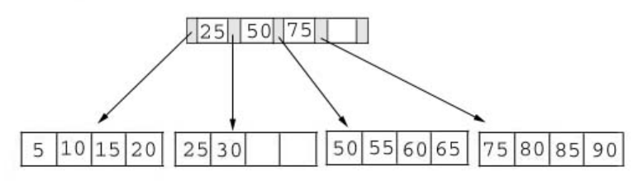








B+ Tree Operations

Slide 28
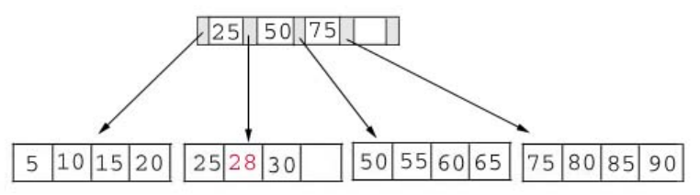





















Slide 29
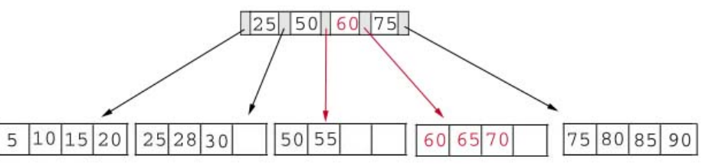

























Slide 30
















Slide 31
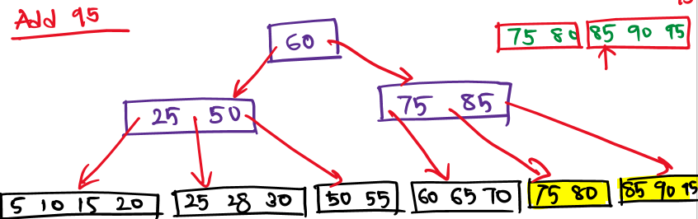




Slide 32






























Slide 33























Slide 34





















Slide 35
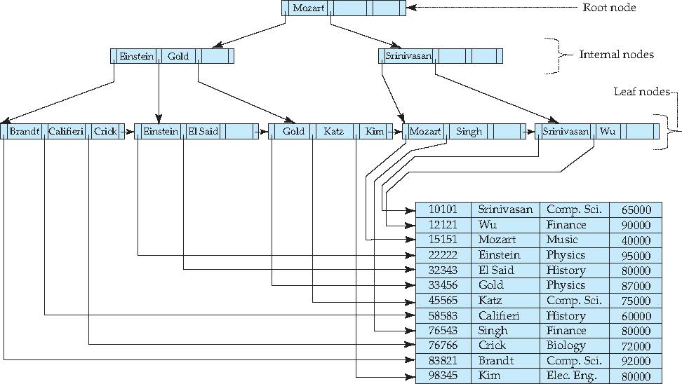
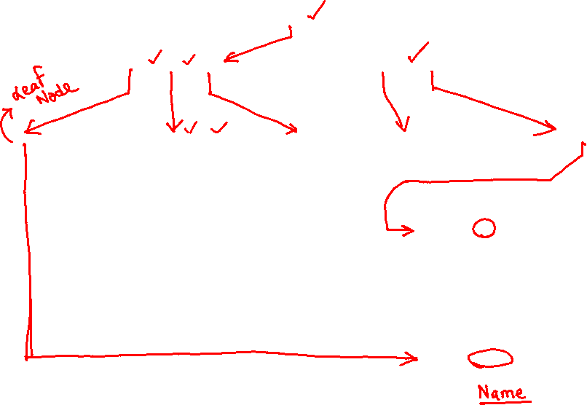
Example of B⁺-Tree

Slide 36
B⁺-Tree Index Files (Cont.)
A B⁺-tree is a rooted tree satisfying the following properties:
All paths from root to leaf are of the same length
Each node that is not a root or a leaf has between ⎡n/2⎤ and n children.
A leaf node has between ⎡(n–1)/2⎤ and n–1 values
Special cases:
If the root is not a leaf, it has at least 2 children.
If the root is a leaf (that is, there are no other nodes in the tree), it can have between 0 and (n–1) values.

Slide 37
B⁺-Tree Node Structure
Typical node
K_{i} are the search-key values
P_{i} are pointers to children (for non-leaf nodes) or pointers to records or buckets of records (for leaf nodes).
The search-keys in a node are ordered
K₁ < K₂ < K₃ < . . . < K_{n–1}
(Initially assume no duplicate keys, address duplicates later)

Slide 38
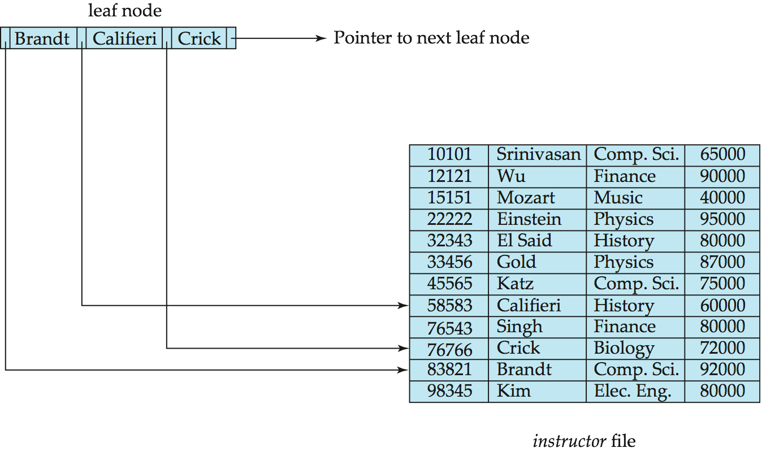
Leaf Nodes in B⁺-Trees
Properties of a leaf node:
For i = 1, 2, . . ., n–1, pointer P_{i} points to a file record with search-key value K_{i},
If L_{i}, L_{j} are leaf nodes and i < j, L_{i}’s search-key values are less than or equal to L_{j}’s search-key values
P_{n} points to next leaf node in search-key order

Slide 39
Non-Leaf Nodes in B⁺-Trees
Non leaf nodes form a multi-level sparse index on the leaf nodes. For a non-leaf node with m pointers:
All the search-keys in the subtree to which P₁ points are less than K₁
For 2 ≤ i ≤ n – 1, all the search-keys in the subtree to which P_{i} points have values greater than or equal to K_{i–1} and less than K_{i}
All the search-keys in the subtree to which P_{n} points have values greater than or equal to K_{n–1}

Slide 40
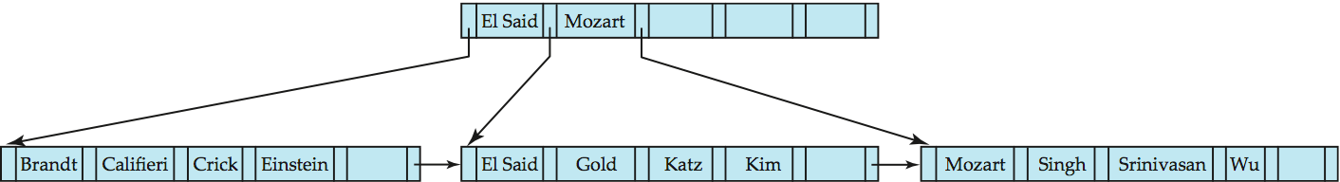
Example of B⁺-tree
B⁺-tree for instructor file (n = 6)
Leaf nodes must have between 3 and 5 values (⎡(n–1)/2⎤ and n –1, with n = 6).
Non-leaf nodes other than root must have between 3 and 6 children (⎡(n/2⎤ and n with n =6).
Root must have at least 2 children.

Slide 41
Observations about B⁺-trees
Since the inter-node connections are done by pointers, “logically” close blocks need not be “physically” close.
The non-leaf levels of the B⁺-tree form a hierarchy of sparse indices.
The B⁺-tree contains a relatively small number of levels
Level below root has at least 2* ⎡n/2⎤ values
Next level has at least 2* ⎡n/2⎤ * ⎡n/2⎤ values
.. etc.
If there are K search-key values in the file, the tree height is no more than ⎡ log_{⎡n/2⎤}(K)⎤
thus searches can be conducted efficiently.
Insertions and deletions to the main file can be handled efficiently, as the index can be restructured in logarithmic time (as we shall see).

Slide 42
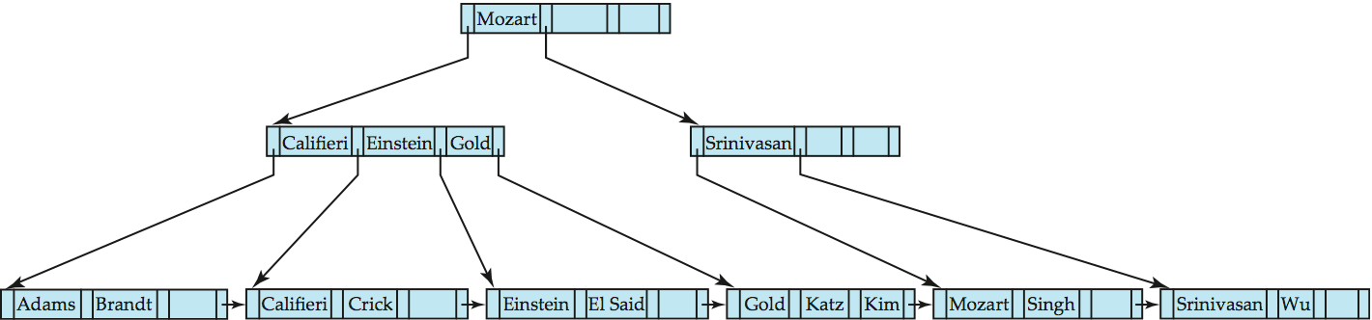
Queries on B⁺-Trees
Find record with search-key value V.
C=root
While C is not a leaf node {
Let i be least value s.t. V ≤ K_{i}.
If no such exists, set C = last non-null pointer in C
Else { if (V= K_{i} ) Set C = P_{i +1} else set C = P_{i}}
}
Let i be least value s.t. K_{i} = V
If there is such a value i, follow pointer P_{i} to the desired record.
Else no record with search-key value k exists.

Slide 43
Handling Duplicates
With duplicate search keys
In both leaf and internal nodes,
we cannot guarantee that K₁ < K₂ < K₃ < . . . < K_{n–1}
but can guarantee K₁ ≤ K₂ ≤ K₃ ≤ . . . ≤ K_{n–1}
Search-keys in the subtree to which P_{i} points
are ≤ K_{i,}, but not necessarily < K_{i,}
To see why, suppose same search key value V is present in two leaf node L_{i} and L_{i+1}. Then in parent node K_{i} must be equal to V

Slide 44
Handling Duplicates
We modify find procedure as follows
traverse P_{i} even if V = K_{i}
As soon as we reach a leaf node C check if C has only search key values less than V
if so set C = right sibling of C before checking whether C contains V
Procedure printAll
uses modified find procedure to find first occurrence of V
Traverse through consecutive leaves to find all occurrences of V
** Errata note: modified find procedure missing in first printing of 6th edition

Slide 45
Queries on B⁺⁻Trees (Cont.)
If there are K search-key values in the file, the height of the tree is no more than ⎡log_{⎡n/2⎤}(K)⎤.
A node is generally the same size as a disk block, typically 4 kilobytes
and n is typically around 100 (40 bytes per index entry).
With 1 million search key values and n = 100
at most log₅₀(1,000,000) = 4 nodes are accessed in a lookup.
Contrast this with a balanced binary tree with 1 million search key values — around 20 nodes are accessed in a lookup
above difference is significant since every node access may need a disk I/O, costing around 20 milliseconds

Slide 46
Updates on B⁺-Trees: Insertion
Find the leaf node in which the search-key value would appear
If the search-key value is already present in the leaf node
Add record to the file
If necessary add a pointer to the bucket.
If the search-key value is not present, then
add the record to the main file (and create a bucket if necessary)
If there is room in the leaf node, insert (key-value, pointer) pair in the leaf node
Otherwise, split the node (along with the new (key-value, pointer) entry) as discussed in the next slide.

Slide 47
Updates on B⁺-Trees: Insertion (Cont.)
Splitting a leaf node:
take the n (search-key value, pointer) pairs (including the one being inserted) in sorted order. Place the first ⎡n/2⎤ in the original node, and the rest in a new node.
let the new node be p, and let k be the least key value in p. Insert (k,p) in the parent of the node being split.
If the parent is full, split it and propagate the split further up.
Splitting of nodes proceeds upwards till a node that is not full is found.
In the worst case the root node may be split increasing the height of the tree by 1.
Result of splitting node containing Brandt, Califieri and Crick on inserting Adams
Next step: insert entry with (Califieri,pointer-to-new-node) into parent

Slide 48
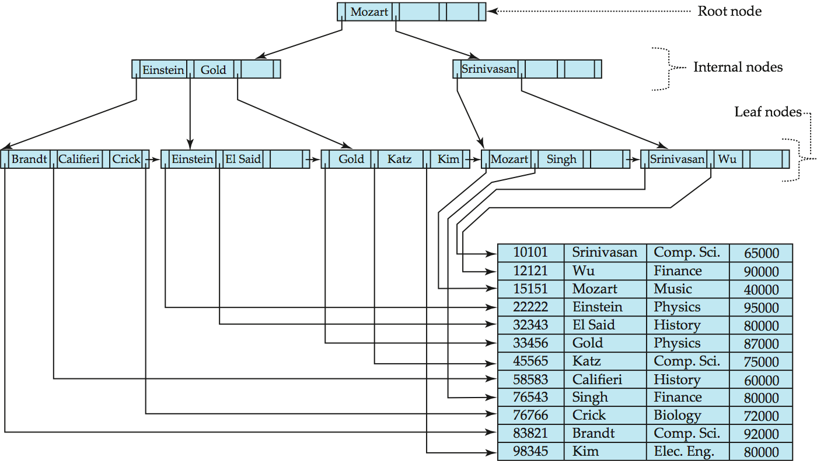
B⁺-Tree Insertion
B⁺-Tree before and after insertion of “Adams”

Slide 49
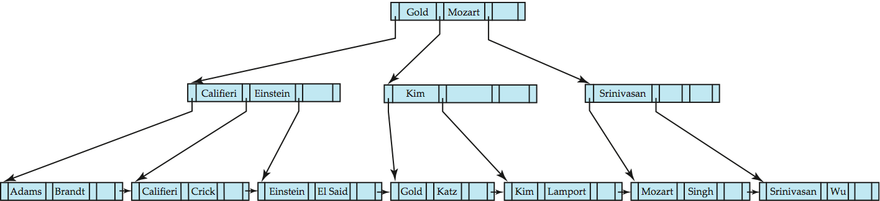
B⁺-Tree Insertion
B⁺-Tree before and after insertion of “Lamport”

Slide 50
Insertion in B⁺-Trees (Cont.)
Splitting a non-leaf node: when inserting (k,p) into an already full internal node N
Copy N to an in-memory area M with space for n+1 pointers and n keys
Insert (k,p) into M
Copy P₁,K₁, …, K _{⎡n/2⎤-1},P _{⎡n/2⎤} from M back into node N
Copy P_{⎡n/2⎤+1},K _{⎡n/2⎤+1},…,K_{n},P_{n+1} from M into newly allocated node N’
Insert (K _{⎡n/2⎤},N’) into parent N
Read pseudocode in book!
Califieri
Adams Brandt Califieri Crick
Adams Brandt
Crick

Slide 51
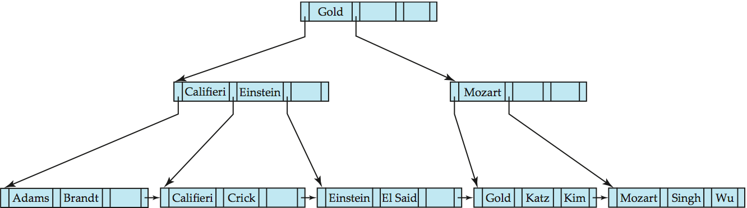
Examples of B⁺-Tree Deletion
Before and after deleting “Srinivasan”
Deleting “Srinivasan” causes merging of under-full leaves

Slide 52
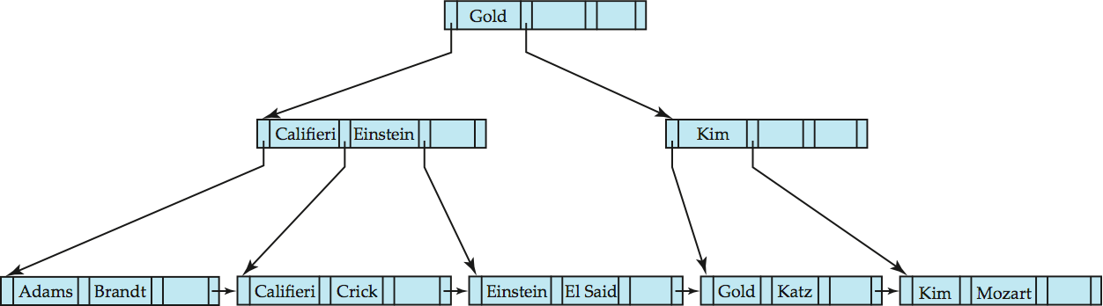
Examples of B⁺-Tree Deletion (Cont.)
Deletion of “Singh” and “Wu” from result of previous example
Leaf containing Singh and Wu became underfull, and borrowed a value Kim from its left sibling
Search-key value in the parent changes as a result

Slide 53
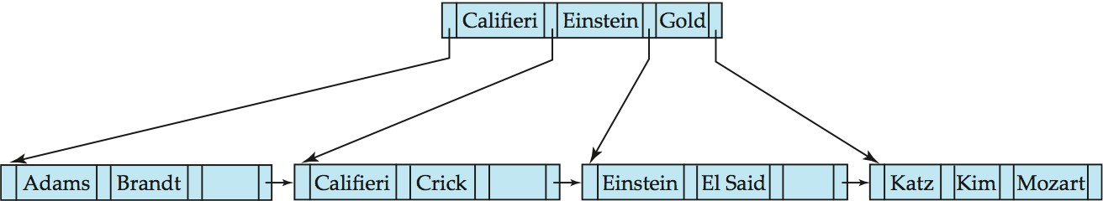
Example of B⁺-tree Deletion (Cont.)
Before and after deletion of “Gold” from earlier example
Node with Gold and Katz became underfull, and was merged with its sibling
Parent node becomes underfull, and is merged with its sibling
Value separating two nodes (at the parent) is pulled down when merging
Root node then has only one child, and is deleted

Slide 54
Updates on B⁺-Trees: Deletion
Find the record to be deleted, and remove it from the main file and from the bucket (if present)
Remove (search-key value, pointer) from the leaf node if there is no bucket or if the bucket has become empty
If the node has too few entries due to the removal, and the entries in the node and a sibling fit into a single node, then merge siblings:
Insert all the search-key values in the two nodes into a single node (the one on the left), and delete the other node.
Delete the pair (K_{i–1}, P_{i}), where P_{i} is the pointer to the deleted node, from its parent, recursively using the above procedure.

Slide 55
Updates on B⁺-Trees: Deletion
Otherwise, if the node has too few entries due to the removal, but the entries in the node and a sibling do not fit into a single node, then redistribute pointers:
Redistribute the pointers between the node and a sibling such that both have more than the minimum number of entries.
Update the corresponding search-key value in the parent of the node.
The node deletions may cascade upwards till a node which has ⎡n/2⎤ or more pointers is found.
If the root node has only one pointer after deletion, it is deleted and the sole child becomes the root.

Slide 56
Non-Unique Search Keys
Alternatives to scheme described earlier
Buckets on separate block (bad idea)
List of tuple pointers with each key
Extra code to handle long lists
Deletion of a tuple can be expensive if there are many duplicates on search key (why?)
Low space overhead, no extra cost for queries
Make search key unique by adding a record-identifier
Extra storage overhead for keys
Simpler code for insertion/deletion
Widely used
Notes:
56

Slide 57
B⁺-Tree File Organization
Index file degradation problem is solved by using B⁺-Tree indices.
Data file degradation problem is solved by using B⁺-Tree File Organization.
The leaf nodes in a B⁺-tree file organization store records, instead of pointers.
Leaf nodes are still required to be half full
Since records are larger than pointers, the maximum number of records that can be stored in a leaf node is less than the number of pointers in a nonleaf node.
Insertion and deletion are handled in the same way as insertion and deletion of entries in a B⁺-tree index.

Slide 58
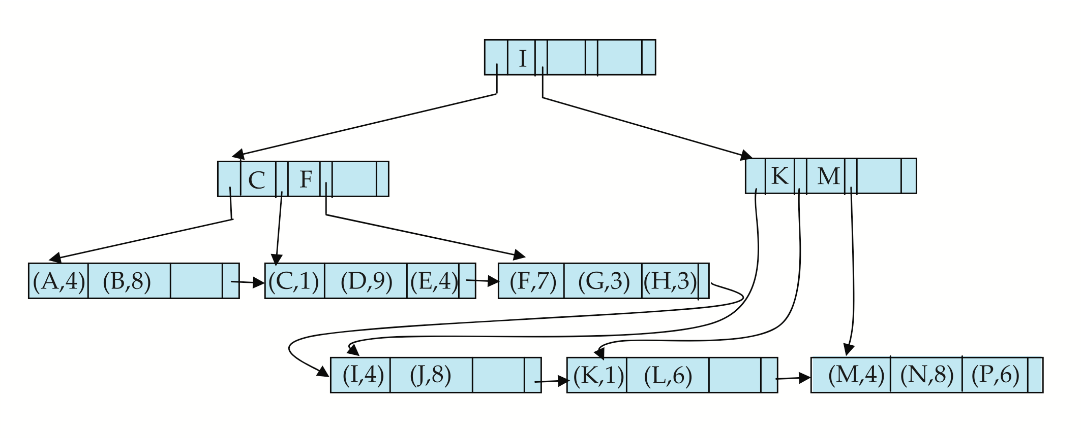
B⁺-Tree File Organization (Cont.)
Example of B⁺-tree File Organization
Good space utilization important since records use more space than pointers.
To improve space utilization, involve more sibling nodes in redistribution during splits and merges
Involving 2 siblings in redistribution (to avoid split / merge where possible) results in each node having at least entries

Slide 59
Other Issues in Indexing
Record relocation and secondary indices
If a record moves, all secondary indices that store record pointers have to be updated
Node splits in B⁺-tree file organizations become very expensive
Solution: use primary-index search key instead of record pointer in secondary index
Extra traversal of primary index to locate record
Higher cost for queries, but node splits are cheap
Add record-id if primary-index search key is non-unique
Notes:
59

Slide 60
Indexing Strings
Variable length strings as keys
Variable fanout
Use space utilization as criterion for splitting, not number of pointers
Prefix compression
Key values at internal nodes can be prefixes of full key
Keep enough characters to distinguish entries in the subtrees separated by the key value
E.g. “Silas” and “Silberschatz” can be separated by “Silb”
Keys in leaf node can be compressed by sharing common prefixes

Slide 61
Bulk Loading and Bottom-Up Build
Inserting entries one-at-a-time into a B⁺-tree requires ≥ 1 IO per entry
assuming leaf level does not fit in memory
can be very inefficient for loading a large number of entries at a time (bulk loading)
Efficient alternative 1:
sort entries first (using efficient external-memory sort algorithms discussed later in Section 12.4)
insert in sorted order
insertion will go to existing page (or cause a split)
much improved IO performance, but most leaf nodes half full
Efficient alternative 2: Bottom-up B⁺-tree construction
As before sort entries
And then create tree layer-by-layer, starting with leaf level
details as an exercise
Implemented as part of bulk-load utility by most database systems

Slide 62
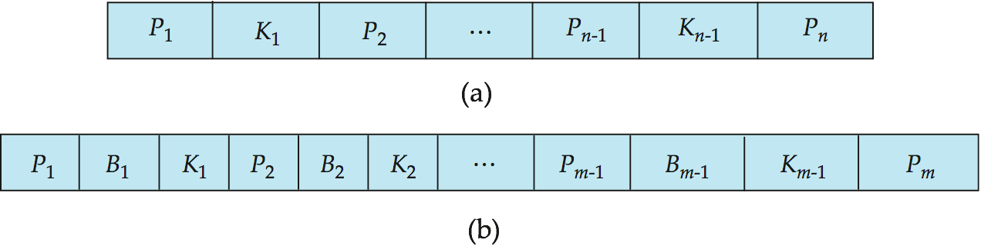
B-Tree Index Files
Similar to B+-tree, but B-tree allows search-key values to appear only once; eliminates redundant storage of search keys.
Search keys in nonleaf nodes appear nowhere else in the B-tree; an additional pointer field for each search key in a nonleaf node must be included.
Generalized B-tree leaf node
Nonleaf node – pointers Bi are the bucket or file record pointers.

Slide 63
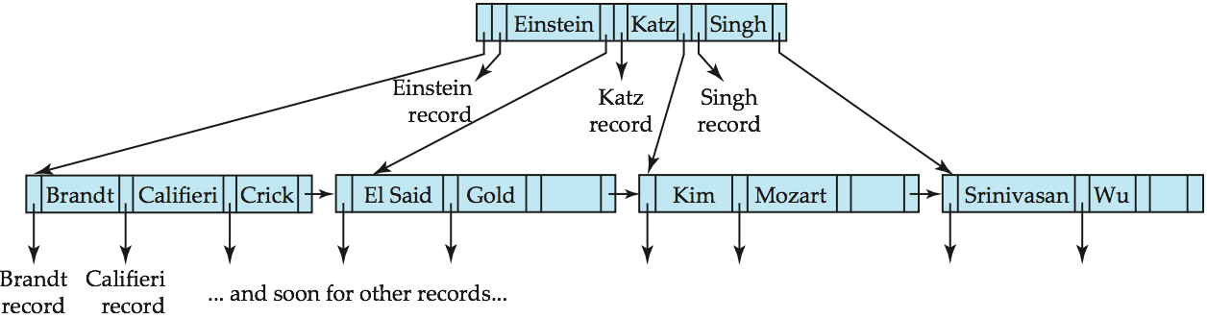
B-Tree Index File Example
B-tree (above) and B+-tree (below) on same data

Slide 64
B-Tree Index Files (Cont.)
Advantages of B-Tree indices:
May use less tree nodes than a corresponding B⁺-Tree.
Sometimes possible to find search-key value before reaching leaf node.
Disadvantages of B-Tree indices:
Only small fraction of all search-key values are found early
Non-leaf nodes are larger, so fan-out is reduced. Thus, B-Trees typically have greater depth than corresponding B⁺-Tree
Insertion and deletion more complicated than in B⁺-Trees
Implementation is harder than B⁺-Trees.
Typically, advantages of B-Trees do not out weigh disadvantages.

Slide 65
Multiple-Key Access
Use multiple indices for certain types of queries.
Example:
select ID
from instructor
where dept_name = “Finance” and salary = 80000
Possible strategies for processing query using indices on single attributes:
1. Use index on dept_name to find instructors with department name Finance; test salary = 80000
2. Use index on salary to find instructors with a salary of $80000; test dept_name = “Finance”.
3. Use dept_name index to find pointers to all records pertaining to the “Finance” department. Similarly use index on salary. Take intersection of both sets of pointers obtained.

Slide 66
Indices on Multiple Keys
Composite search keys are search keys containing more than one attribute
E.g. (dept_name, salary)
Lexicographic ordering: (a₁, a₂) < (b₁, b₂) if either
a₁ < b₁, or
a₁=b₁ and a₂ < b₂

Slide 67
Indices on Multiple Attributes
Suppose we have an index on combined search-key
(dept_name, salary).
With the where clause where dept_name = “Finance” and salary = 80000 the index on (dept_name, salary) can be used to fetch only records that satisfy both conditions.
Using separate indices in less efficient — we may fetch many records (or pointers) that satisfy only one of the conditions.
Can also efficiently handle where dept_name = “Finance” and salary < 80000
But cannot efficiently handle where dept_name < “Finance” and balance = 80000
May fetch many records that satisfy the first but not the second condition

Slide 68
Other Features
Covering indices
Add extra attributes to index so (some) queries can avoid fetching the actual records
Particularly useful for secondary indices
Why?
Can store extra attributes only at leaf

Slide 69
Hashing

Slide 70
Static Hashing
A bucket is a unit of storage containing one or more records (a bucket is typically a disk block).
In a hash file organization we obtain the bucket of a record directly from its search-key value using a hash function.
Hash function h is a function from the set of all search-key values K to the set of all bucket addresses B.
Hash function is used to locate records for access, insertion as well as deletion.
Records with different search-key values may be mapped to the same bucket; thus entire bucket has to be searched sequentially to locate a record.

Slide 71
Example of Hash File Organization
Hash file organization of instructor file, using dept_name as key (See figure in next slide.)
There are 10 buckets,
The binary representation of the ith character is assumed to be the integer i.
The hash function returns the sum of the binary representations of the characters modulo 10
E.g. h(Music) = 1 h(History) = 2 h(Physics) = 3 h(Elec. Eng.) = 3

Slide 72

Example of Hash File Organization
Hash file organization of instructor file, using dept_name as key (see previous slide for details).

Slide 73
Hash Functions
Worst hash function maps all search-key values to the same bucket; this makes access time proportional to the number of search-key values in the file.
An ideal hash function is uniform, i.e., each bucket is assigned the same number of search-key values from the set of all possible values.
Ideal hash function is random, so each bucket will have the same number of records assigned to it irrespective of the actual distribution of search-key values in the file.
Typical hash functions perform computation on the internal binary representation of the search-key.
For example, for a string search-key, the binary representations of all the characters in the string could be added and the sum modulo the number of buckets could be returned. .

Slide 74
Handling of Bucket Overflows
Bucket overflow can occur because of
Insufficient buckets
Skew in distribution of records. This can occur due to two reasons:
multiple records have same search-key value
chosen hash function produces non-uniform distribution of key values
Although the probability of bucket overflow can be reduced, it cannot be eliminated; it is handled by using overflow buckets.

Slide 75
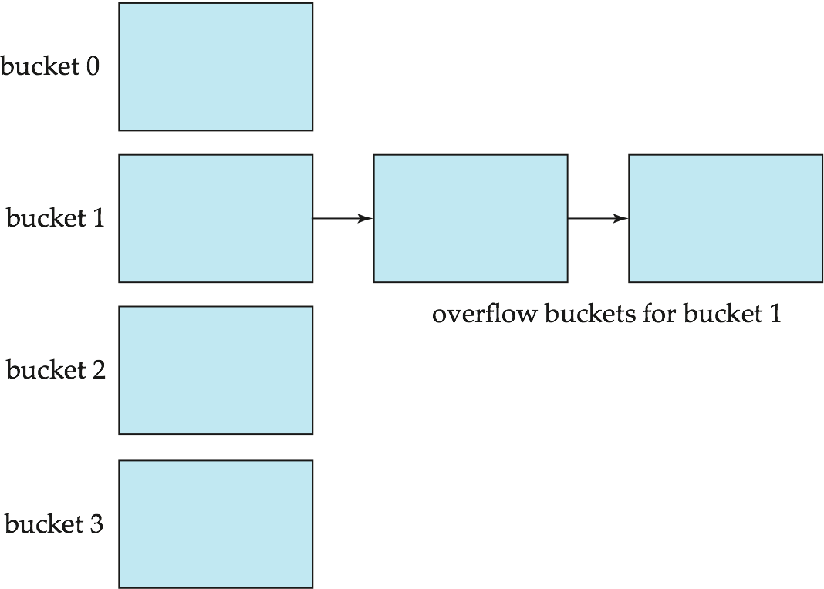
Handling of Bucket Overflows (Cont.)
Overflow chaining – the overflow buckets of a given bucket are chained together in a linked list.
Above scheme is called closed hashing.
An alternative, called open hashing, which does not use overflow buckets, is not suitable for database applications.

Slide 76
Hash Indices
Hashing can be used not only for file organization, but also for index-structure creation.
A hash index organizes the search keys, with their associated record pointers, into a hash file structure.
Strictly speaking, hash indices are always secondary indices
if the file itself is organized using hashing, a separate primary hash index on it using the same search-key is unnecessary.
However, we use the term hash index to refer to both secondary index structures and hash organized files.

Slide 77
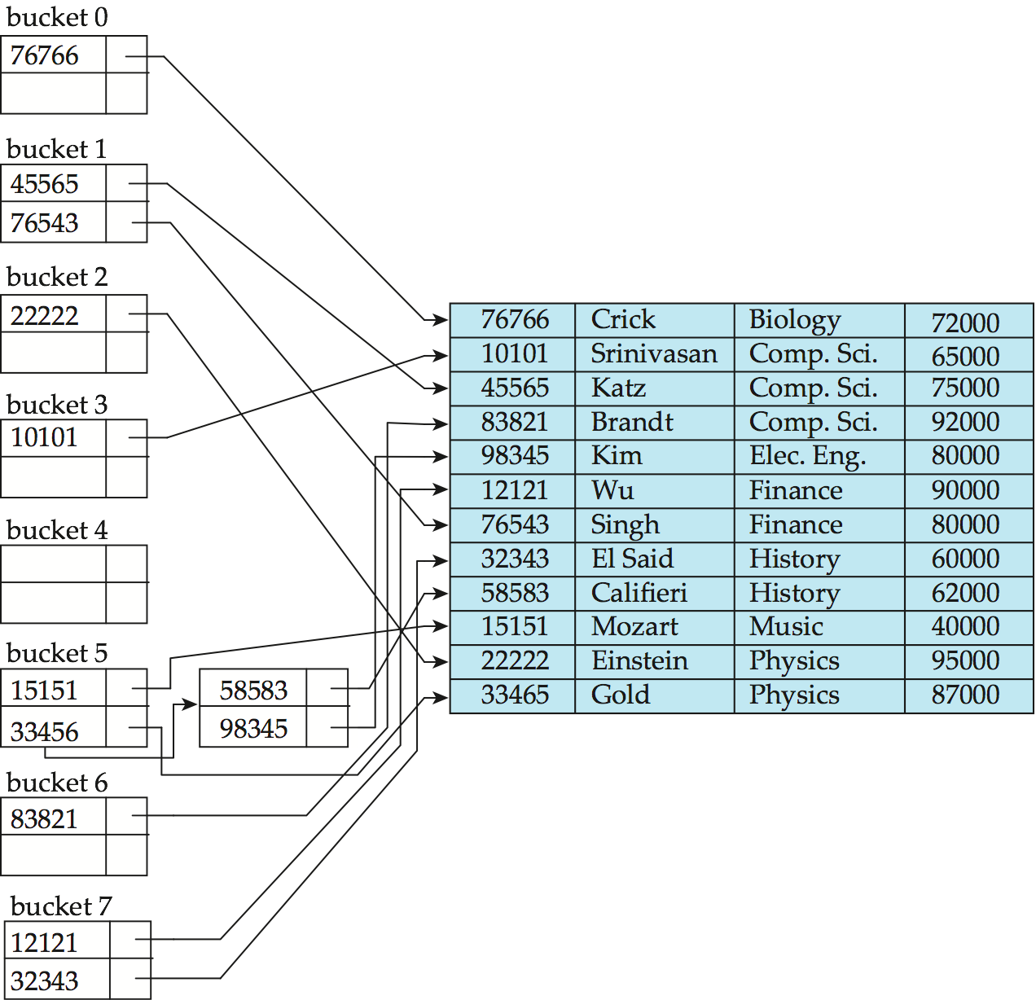
Example of Hash Index
hash index on instructor, on attribute ID

Slide 78
Deficiencies of Static Hashing
In static hashing, function h maps search-key values to a fixed set of B of bucket addresses. Databases grow or shrink with time.
If initial number of buckets is too small, and file grows, performance will degrade due to too much overflows.
If space is allocated for anticipated growth, a significant amount of space will be wasted initially (and buckets will be underfull).
If database shrinks, again space will be wasted.
One solution: periodic re-organization of the file with a new hash function
Expensive, disrupts normal operations
Better solution: allow the number of buckets to be modified dynamically.

Slide 79
Dynamic Hashing
Good for database that grows and shrinks in size
Allows the hash function to be modified dynamically
Extendable hashing – one form of dynamic hashing
Hash function generates values over a large range — typically b-bit integers, with b = 32.
At any time use only a prefix of the hash function to index into a table of bucket addresses.
Let the length of the prefix be i bits, 0 ≤ i ≤ 32.
Bucket address table size = 2^{i.} Initially i = 0
Value of i grows and shrinks as the size of the database grows and shrinks.
Multiple entries in the bucket address table may point to a bucket (why?)
Thus, actual number of buckets is < 2^{i}
The number of buckets also changes dynamically due to coalescing and splitting of buckets.

Slide 80
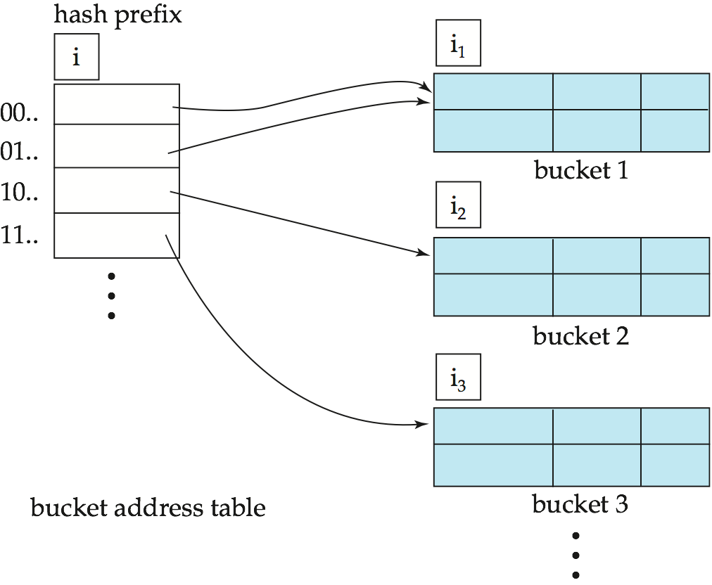
General Extendable Hash Structure
In this structure, i₂ = i₃ = i, whereas i₁ = i – 1 (see next slide for details)

Slide 81
Use of Extendable Hash Structure
Each bucket j stores a value i_{j}
All the entries that point to the same bucket have the same values on the first i_{j} bits.
To locate the bucket containing search-key K_{j}:
1. Compute h(K_{j}) = X
2. Use the first i high order bits of X as a displacement into bucket address table, and follow the pointer to appropriate bucket
To insert a record with search-key value K_{j}
follow same procedure as look-up and locate the bucket, say j.
If there is room in the bucket j insert record in the bucket.
Else the bucket must be split and insertion re-attempted (next slide.)
Overflow buckets used instead in some cases (will see shortly)

Slide 82
Insertion in Extendable Hash Structure (Cont)
To split a bucket j when inserting record with search-key value K_{j}:
If i > i_{j} (more than one pointer to bucket j)
allocate a new bucket z, and set i_{j} = i_{z} = (i_{j} + 1)
Update the second half of the bucket address table entries originally pointing to j, to point to z
remove each record in bucket j and reinsert (in j or z)
recompute new bucket for K_{j} and insert record in the bucket (further splitting is required if the bucket is still full)
If i = i_{j} (only one pointer to bucket j)
If i reaches some limit b, or too many splits have happened in this insertion, create an overflow bucket
Else
increment i and double the size of the bucket address table.
replace each entry in the table by two entries that point to the same bucket.
recompute new bucket address table entry for K_{j} Now i > i_{j} so use the first case above.

Slide 83
Deletion in Extendable Hash Structure
To delete a key value,
locate it in its bucket and remove it.
The bucket itself can be removed if it becomes empty (with appropriate updates to the bucket address table).
Coalescing of buckets can be done (can coalesce only with a “buddy” bucket having same value of i_{j} and same i_{j} –1 prefix, if it is present)
Decreasing bucket address table size is also possible
Note: decreasing bucket address table size is an expensive operation and should be done only if number of buckets becomes much smaller than the size of the table

Slide 84
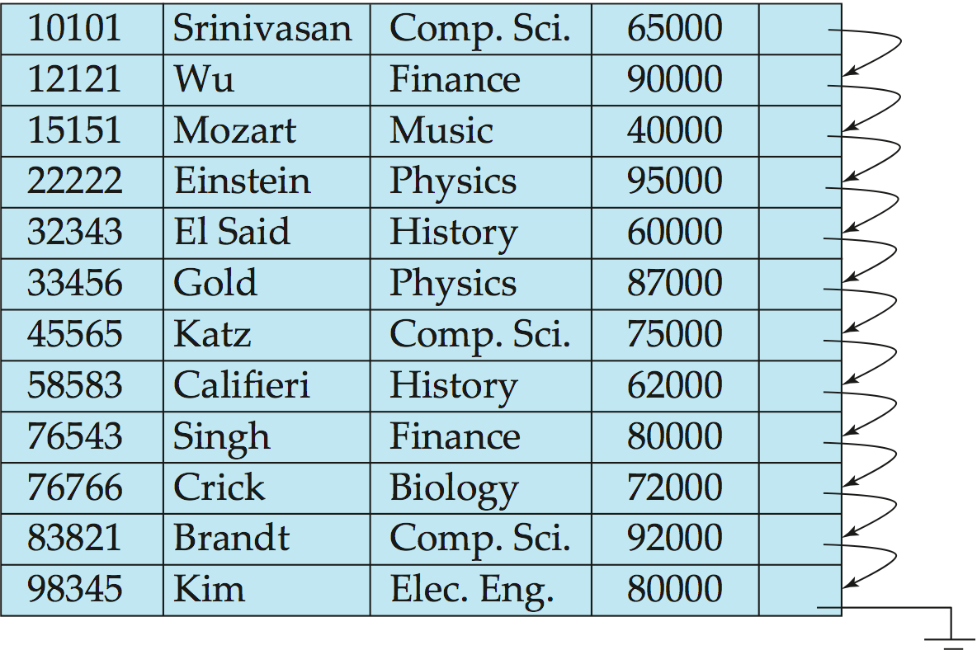
Figure 11.01

Slide 85
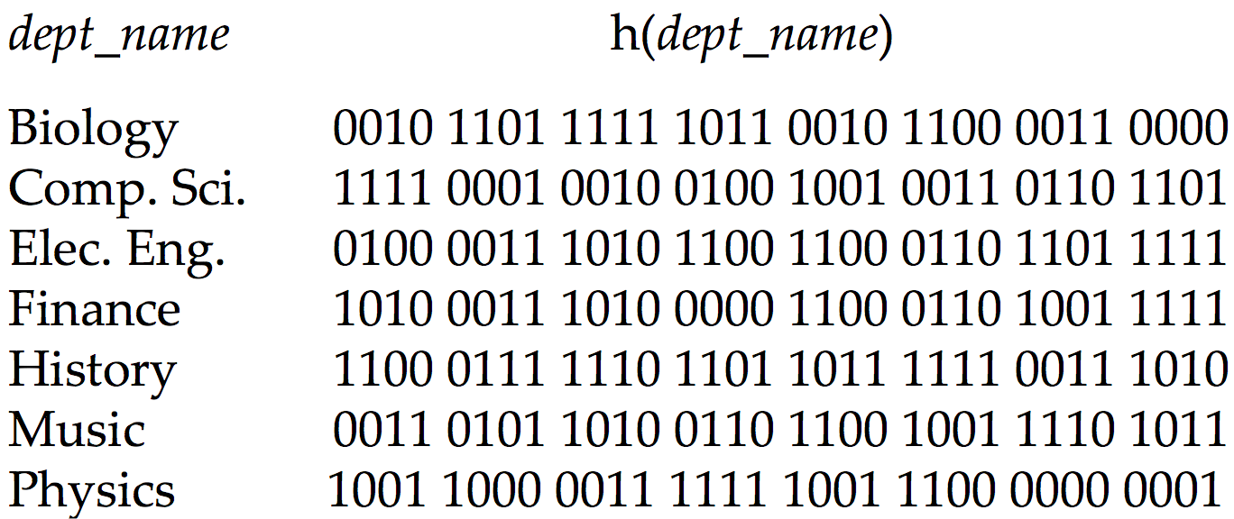
Use of Extendable Hash Structure: Example

Slide 86
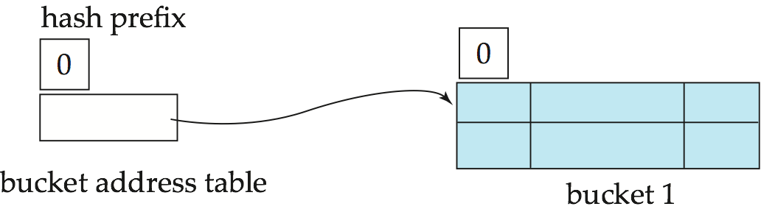
Example (Cont.)
Initial Hash structure; bucket size = 2

Slide 87
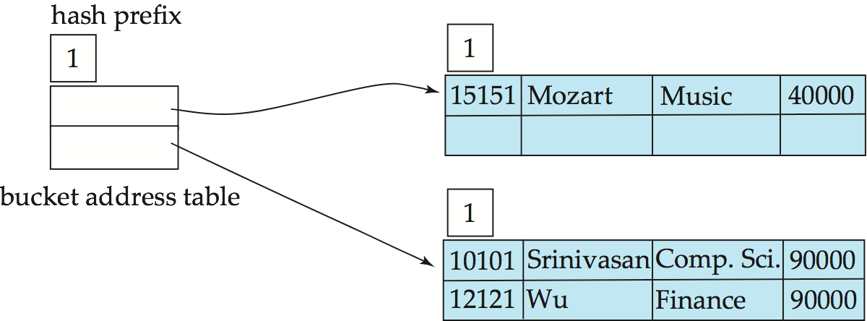
Example (Cont.)
Hash structure after insertion of “Mozart”, “Srinivasan”, and “Wu” records

Slide 88
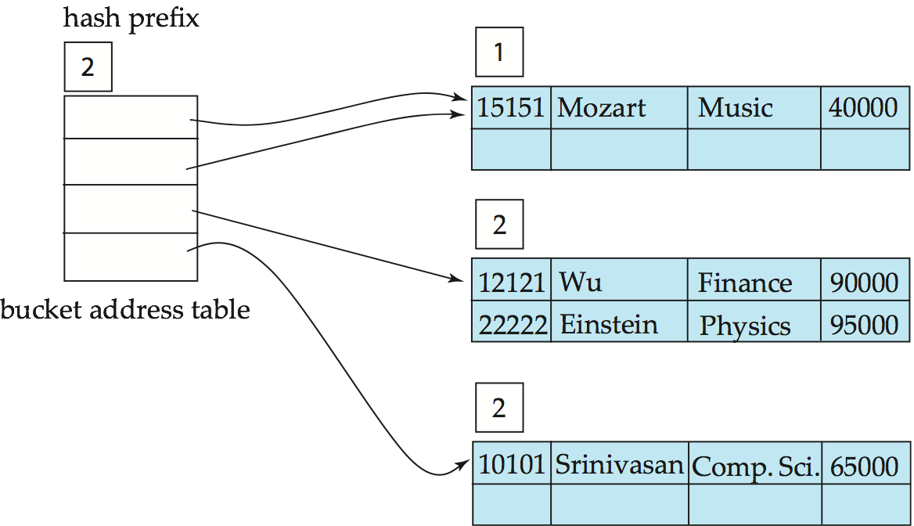
Example (Cont.)
Hash structure after insertion of Einstein record

Slide 89
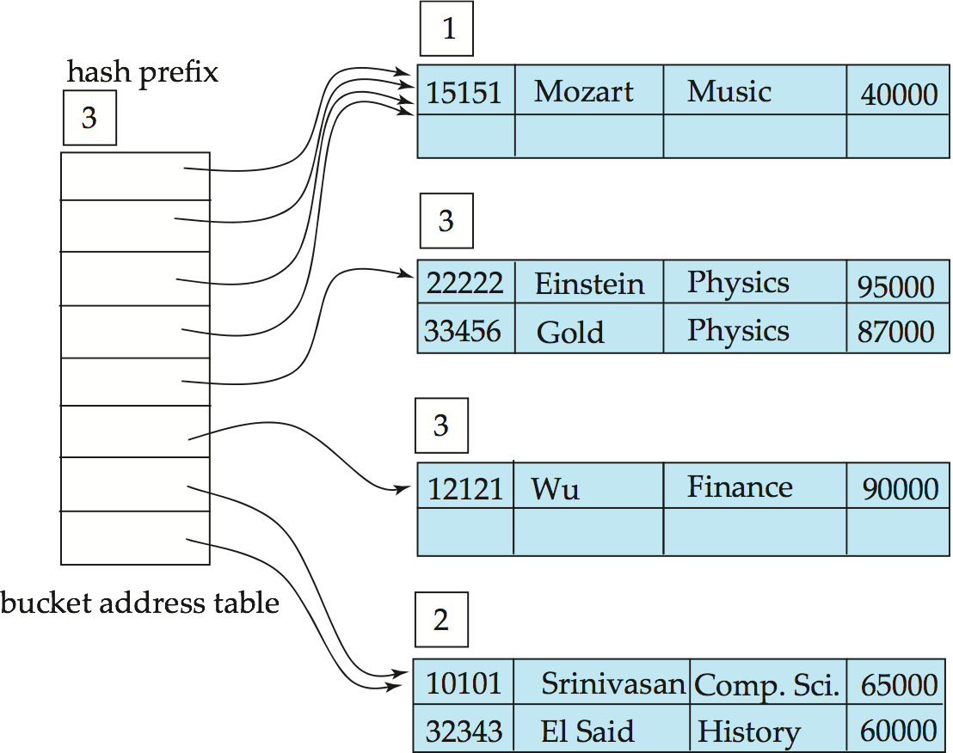
Example (Cont.)
Hash structure after insertion of Gold and El Said records

Slide 90
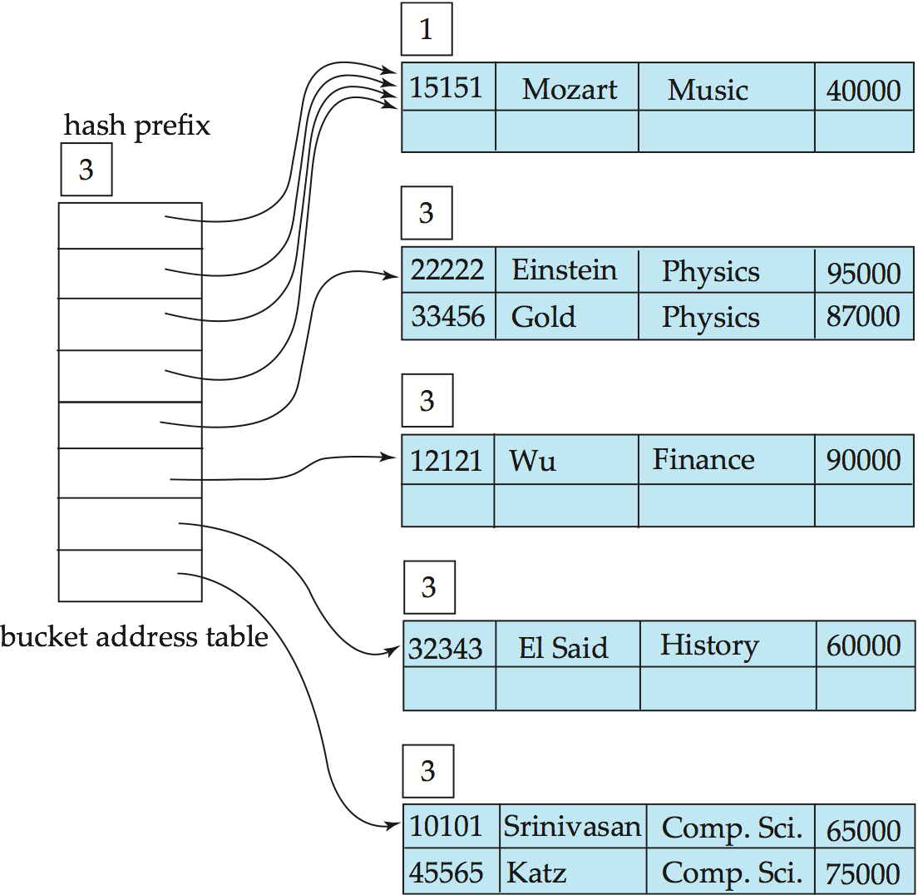
Example (Cont.)
Hash structure after insertion of Katz record

Slide 91
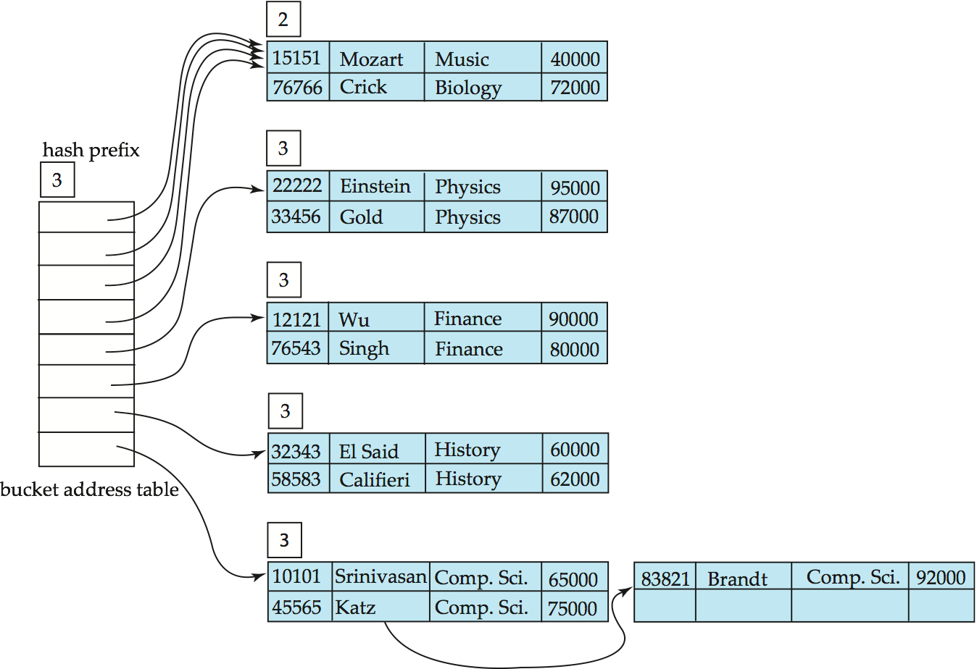
Example (Cont.)
And after insertion of
eleven records

Slide 92
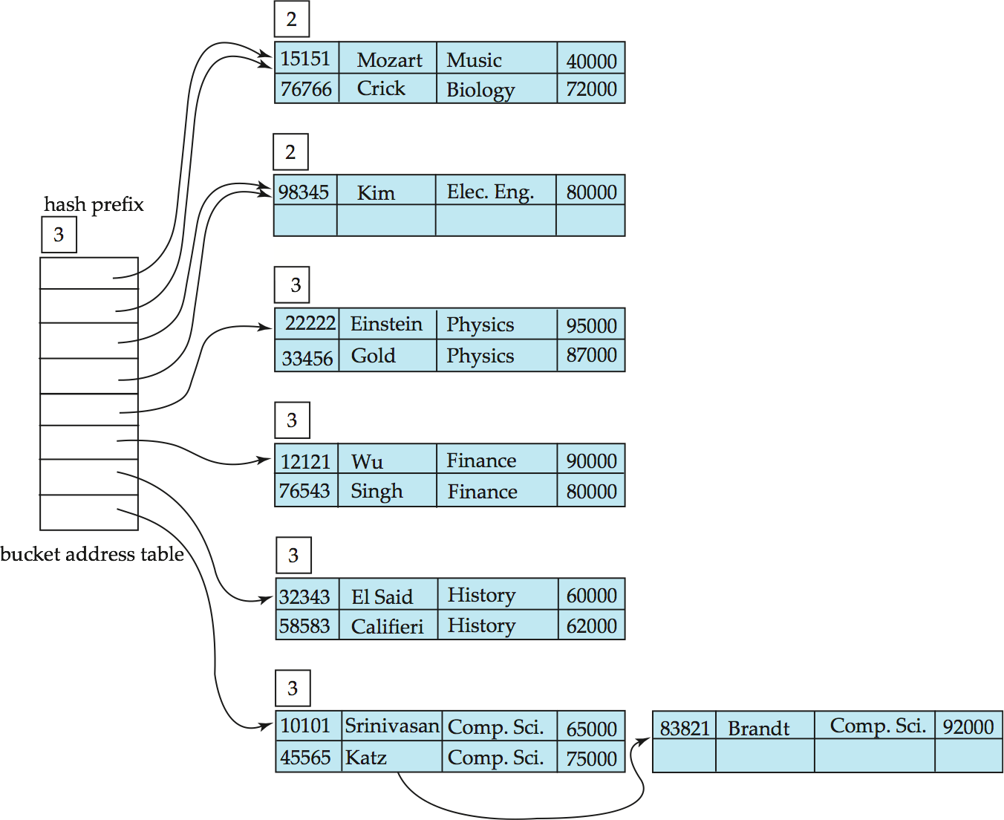
Example (Cont.)
And after insertion of
Kim record in previous
hash structure

Slide 93
Extendable Hashing vs. Other Schemes
Benefits of extendable hashing:
Hash performance does not degrade with growth of file
Minimal space overhead
Disadvantages of extendable hashing
Extra level of indirection to find desired record
Bucket address table may itself become very big (larger than memory)
Cannot allocate very large contiguous areas on disk either
Solution: B⁺-tree structure to locate desired record in bucket address table
Changing size of bucket address table is an expensive operation
Linear hashing is an alternative mechanism
Allows incremental growth of its directory (equivalent to bucket address table)
At the cost of more bucket overflows

Slide 94
Comparison of Ordered Indexing and Hashing
Cost of periodic re-organization
Relative frequency of insertions and deletions
Is it desirable to optimize average access time at the expense of worst-case access time?
Expected type of queries:
Hashing is generally better at retrieving records having a specified value of the key.
If range queries are common, ordered indices are to be preferred
In practice:
PostgreSQL supports hash indices, but discourages use due to poor performance
Oracle supports static hash organization, but not hash indices
SQLServer supports only B⁺-trees

Slide 95
Bitmap Indices
Bitmap indices are a special type of index designed for efficient querying on multiple keys
Records in a relation are assumed to be numbered sequentially from, say, 0
Given a number n it must be easy to retrieve record n
Particularly easy if records are of fixed size
Applicable on attributes that take on a relatively small number of distinct values
E.g. gender, country, state, …
E.g. income-level (income broken up into a small number of levels such as 0-9999, 10000-19999, 20000-50000, 50000- infinity)
A bitmap is simply an array of bits

Slide 96
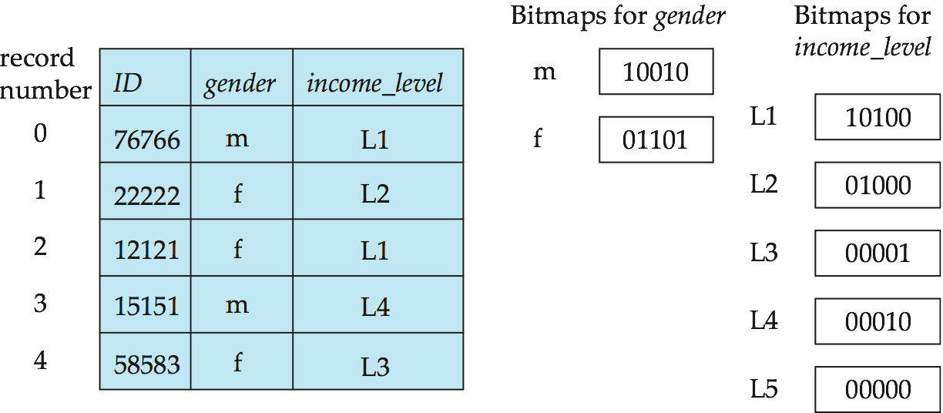
Bitmap Indices (Cont.)
In its simplest form a bitmap index on an attribute has a bitmap for each value of the attribute
Bitmap has as many bits as records
In a bitmap for value v, the bit for a record is 1 if the record has the value v for the attribute, and is 0 otherwise

Slide 97
Bitmap Indices (Cont.)
Bitmap indices are useful for queries on multiple attributes
not particularly useful for single attribute queries
Queries are answered using bitmap operations
Intersection (and)
Union (or)
Complementation (not)
Each operation takes two bitmaps of the same size and applies the operation on corresponding bits to get the result bitmap
E.g. 100110 AND 110011 = 100010
100110 OR 110011 = 110111 NOT 100110 = 011001
Males with income level L1: 10010 AND 10100 = 10000
Can then retrieve required tuples.
Counting number of matching tuples is even faster

Slide 98
Bitmap Indices (Cont.)
Bitmap indices generally very small compared with relation size
E.g. if record is 100 bytes, space for a single bitmap is 1/800 of space used by relation.
If number of distinct attribute values is 8, bitmap is only 1% of relation size
Deletion needs to be handled properly
Existence bitmap to note if there is a valid record at a record location
Needed for complementation
not(A=v): (NOT bitmap-A-v) AND ExistenceBitmap
Should keep bitmaps for all values, even null value
To correctly handle SQL null semantics for NOT(A=v):
intersect above result with (NOT bitmap-A-Null)

Slide 99
Efficient Implementation of Bitmap Operations
Bitmaps are packed into words; a single word and (a basic CPU instruction) computes and of 32 or 64 bits at once
E.g. 1-million-bit maps can be and-ed with just 31,250 instruction
Counting number of 1s can be done fast by a trick:
Use each byte to index into a precomputed array of 256 elements each storing the count of 1s in the binary representation
Can use pairs of bytes to speed up further at a higher memory cost
Add up the retrieved counts
Bitmaps can be used instead of Tuple-ID lists at leaf levels of B⁺-trees, for values that have a large number of matching records
Worthwhile if > 1/64 of the records have that value, assuming a tuple-id is 64 bits
Above technique merges benefits of bitmap and B⁺-tree indices

Slide 100
Index Definition in SQL
Create an index
create index <index-name> on <relation-name> (<attribute-list>)
E.g.: create index b-index on branch(branch_name)
Use create unique index to indirectly specify and enforce the condition that the search key is a candidate key is a candidate key.
Not really required if SQL unique integrity constraint is supported
To drop an index
drop index <index-name>
Most database systems allow specification of type of index, and clustering.

Slide 101
End of Chapter

Slide 102
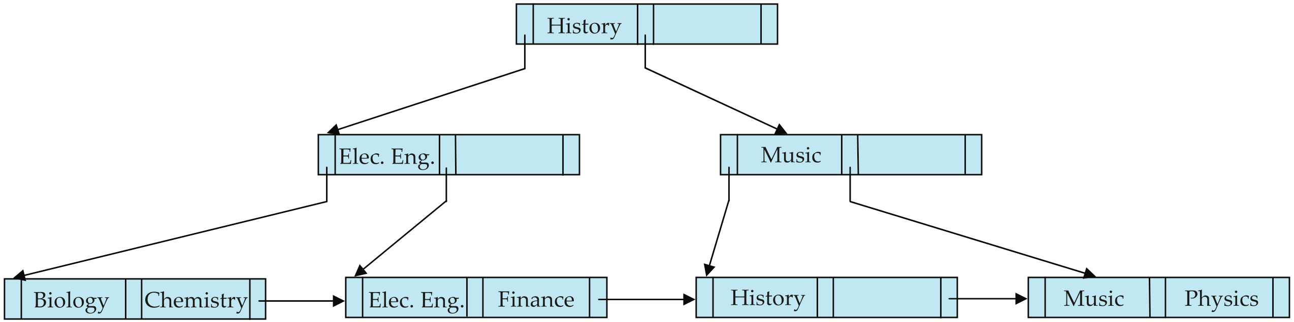
Figure 11.15

Slide 103
Partitioned Hashing
Hash values are split into segments that depend on each attribute of the search-key.
(A₁, A₂, . . . , A_{n}) for n attribute search-key
Example: n = 2, for customer, search-key being (customer-street, customer-city)
search-key value hash value (Main, Harrison) 101 111 (Main, Brooklyn) 101 001 (Park, Palo Alto) 010 010 (Spring, Brooklyn) 001 001 (Alma, Palo Alto) 110 010
To answer equality query on single attribute, need to look up multiple buckets. Similar in effect to grid files.

Slide 104
Grid Files
Structure used to speed the processing of general multiple search-key queries involving one or more comparison operators.
The grid file has a single grid array and one linear scale for each search-key attribute. The grid array has number of dimensions equal to number of search-key attributes.
Multiple cells of grid array can point to same bucket
To find the bucket for a search-key value, locate the row and column of its cell using the linear scales and follow pointer

Slide 105
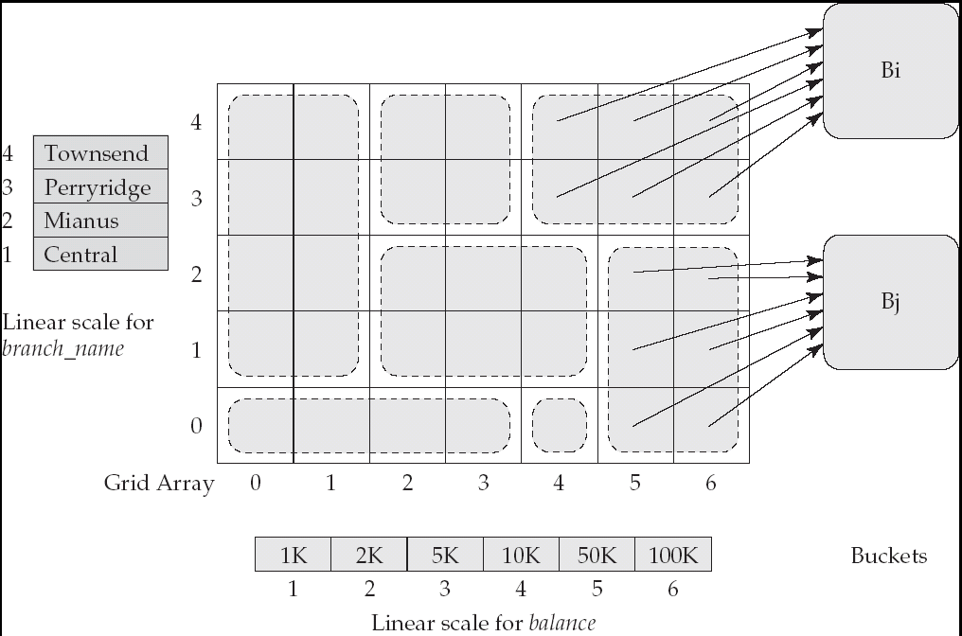
Example Grid File for account

Slide 106
Queries on a Grid File
A grid file on two attributes A and B can handle queries of all following forms with reasonable efficiency
(a₁ ≤ A ≤ a₂)
(b₁ ≤ B ≤ b₂)
(a₁ ≤ A ≤ a₂ ∧ b₁ ≤ B ≤ b₂),.
E.g., to answer (a₁ ≤ A ≤ a₂ ∧ b₁ ≤ B ≤ b₂), use linear scales to find corresponding candidate grid array cells, and look up all the buckets pointed to from those cells.

Slide 107
Grid Files (Cont.)
During insertion, if a bucket becomes full, new bucket can be created if more than one cell points to it.
Idea similar to extendable hashing, but on multiple dimensions
If only one cell points to it, either an overflow bucket must be created or the grid size must be increased
Linear scales must be chosen to uniformly distribute records across cells.
Otherwise there will be too many overflow buckets.
Periodic re-organization to increase grid size will help.
But reorganization can be very expensive.
Space overhead of grid array can be high.
R-trees (Chapter 23) are an alternative

